Slide 1
Lecture 1: Welcome to Programming II!
Topics: Syllabus, Review of Programming I, Part I
Chapters 1 - 5

Slide 2
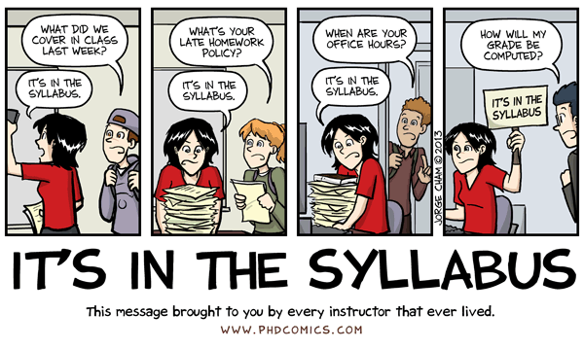
Where can I find everything?

Slide 3
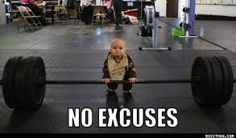
I lost my syllabus…
It’s online! http://homepages.neiu.edu/~retrana/CS207_1.html

Slide 4

Office Hours
Tuesdays: 3:00 p.m. - 4:00 p.m.
5:30 p.m. - 6:30 p.m.
Thursdays: 3:00 p.m. - 4:00 p.m.
LWH 3006

Slide 5
Piazza
An online resource that has a website specific to this course where students can post course-related questions. It is a discussion forum for this course.
Students can also answer each others’ questions (politely!!).
I will also monitor the discussion forum and help to clarify responses or answer questions, if needed.
Sign-up for CS207-1 on Piazza: http://piazza.com/neiu/spring2016/cs2071
Piazza homepage for this course: http://piazza.com/neiu/spring2016/cs2071/home

Slide 6
Peer Leaders
Ashley Torres, Morris Ballenger, Jason Merrill
PLTL (Peer Led Team Learning) Hours: Ashley Torres: Wednesdays, 3 pm - 5 pm, Location: LWH 3102/3103 Morris Ballenger: Tuesdays, 7 pm – 9 pm, Location: LWH 3102/3103 Jason Merrill: Wednesdays, 10 am - 12 pm, Location: LWH 3102/3103
When: PLTL begins 01/19/16
What is Peer Led Team Learning? An opportunity to work through additional problems that reinforce the material learned in class. This is not where you go to get help with homework!
Extra credit: If you attend 3 or more sessions this semester, I will increase your final grade (IF you have passed the final) by 2%!
You must bring your student ID to PLTL for the purpose of recording attendance.
Peer leaders will also be monitoring Piazza to help with answering questions.

Slide 7

Emails
Emails are answered ONCE per weekday. Weekend emails will be answered early on Sunday evenings.
Do not send me your code in an email. Questions regarding code should be discussed during office hours or on the discussion forum (Piazza).
Per university policy, I do not discuss grades via email.
All course-related questions should be posted on Piazza.

Slide 8
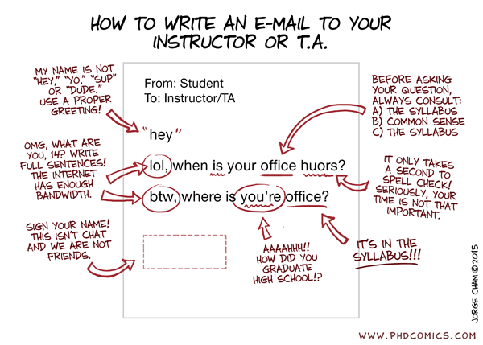

Slide 9
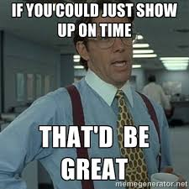
Attendance
Attendance is mandatory.
It counts for 5% of your grade.
Students are allowed a maximum of 3 absences (excused/unexcused/otherwise).
After the three permitted absences, any subsequent absences result in a direct deduction from the total number of possible classes.
If you miss a class, it is your responsibility to review the posted lecture/discuss with classmates/make up the homework/come to office hours, etc.

Slide 10
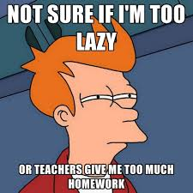
Homework
Homework will be posted on the course website.
Completed homework should be submitted to the specified D2L dropbox.
While working on homework assignments with other students is encouraged, plagiarism is NOT tolerated.
All work should be unique. Students that submit duplicate/identical work will receive an F for that homework assignment.
All assignments must be submitted by the specified due date and time.
There are NO exceptions (i.e. don’t wait until the last possible second to submit your homework. You will not receive an extension).

Slide 11
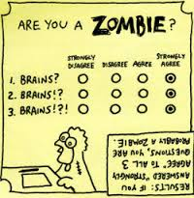
Exams
There will be three exams (see the course schedule), each worth 15% of the final grade.
There are NO make-up exams.
If there is any suspicion/evidence of cheating during exams, the student(s) involved will be given an F for that assignment (I also reserve the right to give you an F in the course if you cheat).

Slide 12

Final Exam
There will be a common final exam for all sections of Programming II.
The CS 207 common final is scheduled for Saturday, April 30th at 11:00 a.m. - 1:00 p.m in LWH 1001.
If you cannot attend Saturday because of a religious reason (or other serious reason), you must notify me by email within the first two weeks of the semester in order to be accommodated.
You MUST receive a grade of at least 60% on the Final Exam in order to receive a grade of "C" or higher for the course. If you do not, you will receive a "D" or an "F" for the course, depending on your weighted average.

Slide 13
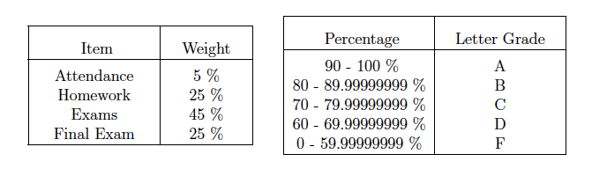
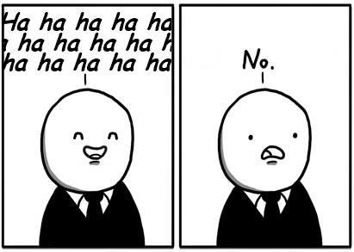
Grading

Slide 14
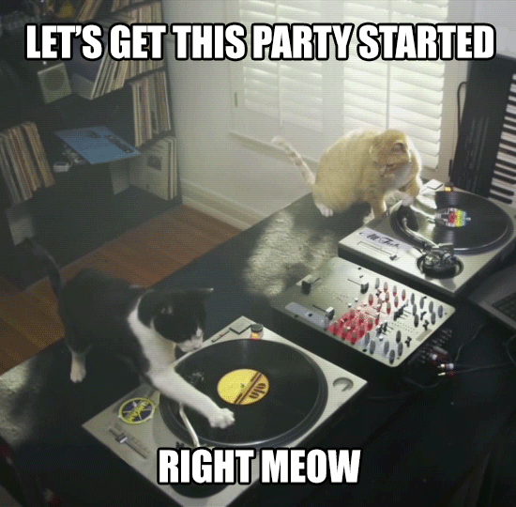
Let’s get started with a review of Programming I!

Slide 15
Creating a class with a main method
Start the name of the class with a capital letter.
Start every word within a class name with a capital letter (camel-case).
Make sure you have opening and closing braces.
Make sure the name of your .java file has exactly the same name as your class.
Opening brace
Class name
The main method
public class MyFirstClass
{
public static void main(String[] args)
{
System.out.println("Welcome to Programming II!");
}
}
Closing brace
Notes:
In this class I will put braces on their own line. This is a matter of preference.

Slide 16
Variables and Expressions
A variable is used to store a value in memory that can change as a program executes.
Before you can use a variable, you must declare its data type and name.
You must assign a value to a variable to initialize it.
data type
name
assignment
data type
int quantity = 1;
double totalEggs;
totalEggs = 4.0;
name
assignment

Slide 17
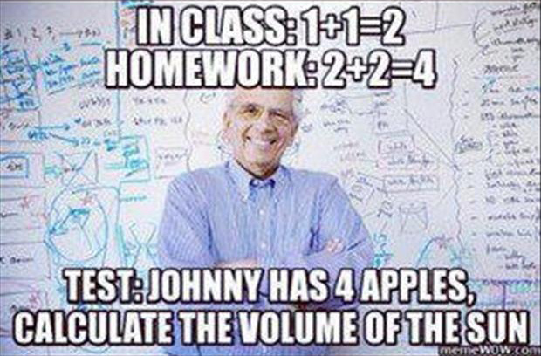
Data Types and Arithmetic Operators
int
double
char
boolean
Arithmetic Operators:
+ addition
- subtraction
* multiplication
/ division
% modulus (remainder)

Slide 18
Arithmetic Operators: Examples
int x = 15;
int y = 6;
int result = x / y;
What is stored in the variable result?
2
int x = 15;
int y = 6;
double result = x / y;
What is stored in the variable result?
2.0
double x = 15;
double y = 6;
double result = x / y;
What is stored in the variable result?
2.5

Slide 19
Shortcut Assignment Operators
int month = 1;
month = month + 1;
month++;
int day = 4;
month = month + day;
month += day;
day = day – 1;
day -= 1;
day--;
Memory
month: 1
/
2
/
3
/
/
7
11
day: 4
/
/
3
2
/
1

Slide 20
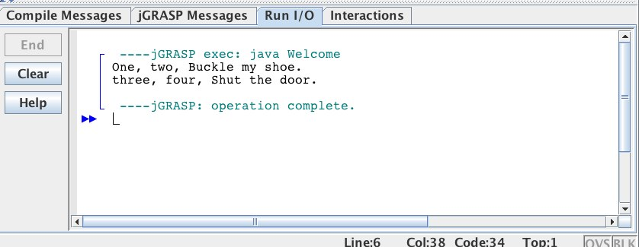
Keyboard and Screen I/O
println(data) : Prints the data followed by a new line character.
print(data) : Prints the data without starting a new line.
System.out.print("One, two, ");
System.out.println("Buckle my shoe.");
System.out.print("three, four, ");
System.out.println("Shut the door.");

Slide 21
The Scanner Class
Handles keyboard input.
java.util.Scanner : Import the Scanner class from the java.util package (library) at the beginning of your file.
To create a Scanner object:
Scanner input = new Scanner(System.in);
Common methods from the Scanner class:
nextInt() : Returns the next input as an integer value
nextDouble() : Returns the next input as a double value
nextLine() : Returns any remaining input on the current line as a String and goes to the next line.

Slide 22
The String Class
A String can consist of any characters in the character set - letters, numbers, etc.
To specify the value of the string, enclose it in double quotation marks. This is called a string literal.
Empty string: ""
Some methods in the String class: charAt(), compareTo(), equals(), equalsIgnoreCase(), length(), toLowerCase(), toUpperCase()

Slide 23
The String Class
String message = "Welcome to the class!";
String firstName = "John";
String lastName = "Smith";
String name = firstName + " " + lastName;
System.out.println(name);
String sentence = "This is fun!";
System.out.print(sentence.charAt(1));
System.out.print(sentence.charAt(2));
System.out.print(sentence.charAt(11));
Output
John Smith
h
i
!

Slide 24
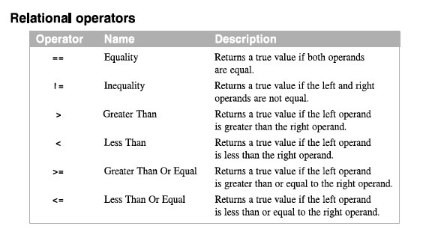
Boolean Expressions

Slide 25
Boolean Expressions: Examples
int month = 1;
month == 5;
double rate = 7.25;
rate <= 8;
false
true
int day = 14;
day != 13;
double pay = 9.25;
pay < 9.25;
true
false

Slide 26
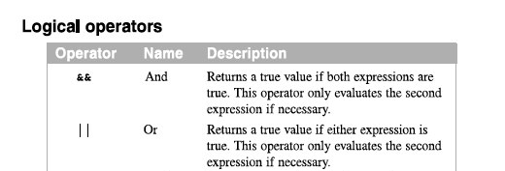
Logical Operators

Slide 27
Logical Expressions: Examples
int month = 5;
(month > 2) && (month <= 7);
int month = 2;
(month > 2) && (month <= 7);
true
true
true
false
false
true
int month = 7;
(month > 1) || (month < 6);
int month = 3;
(month > 5) || (month < 2);
true
true
false
false
false
false

Slide 28
If-Else Statements
double salary = 8.25;
if (salary > 7.00)
{
System.out.print(“Woohoo! Promotion!”);
}
These are the same! The second one does not have braces. What is the rule for not using braces?
double salary = 8.25;
if (salary > 7.00)
System.out.print(“Woohoo! Promotion!”);

Slide 29
If-Else Statements
double score = 88.5;
if (score >= 70)
{
System.out.print("Passing");
}
else
{
System.out.print("Failing");
}
double score = 88.5;
if (score >= 70)
System.out.print("Passing");
else
System.out.print("Failing");
These are the same! The second one does not have braces. What is the rule for not using braces?

Slide 30
If-Else Statements
double score = 88.5;
if (score >= 90)
{
System.out.print("A");
}
else if (score >= 80)
{
System.out.print("B");
}
else if (score >= 70)
{
System.out.print("C");
}
else
{
System.out.print("Oh Well…");
}
Output
B

Slide 31
If-Else Statements
double score = 88.5;
if (score >= 70)
{
System.out.print("C");
}
else if (score >= 80)
{
System.out.print("B");
}
else if (score >= 90)
{
System.out.print("A");
}
else
{
System.out.print("Oh Well…");
}
Output
C

Slide 32
Nested If Statements
int age = 67;
if (age < 13)
System.out.println("You are but a wee child.");
else if (age < 20)
System.out.println("You are a teenager, not a child");
else
{
if (age < 65)
System.out.println("You are an adult");
else
System.out.println("You are a senior! Enjoy life!");
}
Output
You are a senior! Enjoy life!

Slide 33
While Loops
while (boolean expression)
{
// Do stuff
}
Body of loop can be executed zero times depending on the boolean expression.
What is the difference?
Body of loop always executed at least once
do
{
// Do stuff
}
while (boolean expression);
Note the semi-colon

Slide 34
While Loops
Scanner kb = new Scanner(System.in); int total = 0; System.out.print("Please enter a positive integer: "); int next = kb.nextInt(); while (next > 0)
{ total = total + next; System.out.print("Please enter a positive integer: "); next = kb.nextInt(); } System.out.print("The total is " + total);
If next is positive, then execute the statements in the loop.
If next is negative, ignore the statements and move on.

Slide 35
Do-While Loops
Scanner kb = new Scanner(System.in); int total = 0; System.out.print("Please enter a positive integer: "); int next = kb.nextInt(); do
{ total = total + next; System.out.print("Please enter a positive integer: "); next = kb.nextInt();
}
while (next > 0); System.out.print("The total is " + total);

Slide 36
While Loops
Scanner kb = new Scanner(System.in);
int total = 0; System.out.print("Please enter a positive integer:"); int next = kb.nextInt();
while (next > 0)
{ total = total + next; if (total < 15)
{ System.out.print("Please enter a positive integer:"); next = kb.nextInt(); }
else
{ System.out.print("Please enter a negative integer:"); next = kb.nextInt(); } } System.out.print("The total is " + total);

Slide 37
For Loops
Problem: Print out the integers from 1 to 5
Start value
Boolean expression
Increment
for (int x = 1; x <= 5; x++)
{
System.out.println("The value of x is " + x);
}

Slide 38

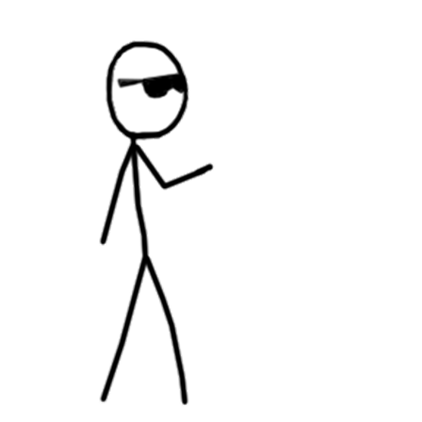
For Loops
Problem: Print out the sum of the integers 1 through 10.
That’s easy.
I don’t need a for loop.
I can do it in my head.
Fine. Sum 75 to 85.

Slide 39
Nested For Loops
A for loop can be placed inside of another for loop (aka “nested”).
for (int i = 1; i <= 5, i++)
{
for (int j = 1; j <= i; j++)
{
System.out.print("*");
}
System.out.print("\n");
}
*
**
***
****
*****
Outer Loop
Inner Loop
What does this code do?

Slide 40

That’s all for today!

